Slide 1
Ritu Shah
QSO 560: Descriptive analysis
MBA: Master of Business Administration
Prof. Alhamis
Aug 17, 2023

Slide 2
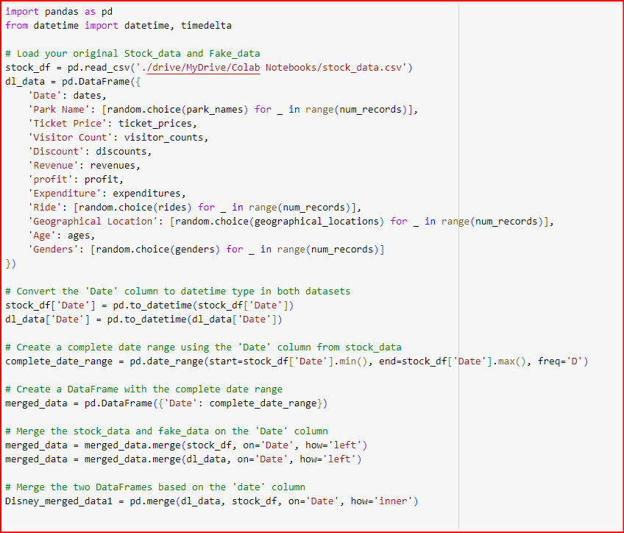
# Import necessary libraries
import pandas as pd
import random
import string
from datetime import datetime, timedelta
# These are the libraries to collect the data

Slide 3
# Explanation of the code:
# The code you provided demonstrates the generation of synthetic data for a theme park and the collection of real stock data from a CSV file. It uses the panda’s library to handle data in a tabular format (DataFrames), random and datetime libraries for generating data, and the Google Drive integration from the Colab environment to access files.
# Synthesize Theme Park Data Generation:
- Start by importing the required libraries: pandas for data manipulation, random for generating random values, a string for handling strings, and DateTime for working with dates and times.
- Generate synthetic data for a theme park with attributes like 'Park Name', 'Ticket Price', 'Visitor Count', 'Discount', 'Revenue', 'Profit', 'Expenditure', 'Ride', 'Geographical Location', 'Age', and 'Gender'. This data simulates various aspects of the theme park business.
- The 'Date' attribute is generated using a date range between 'start_date' and 'end_date'.
- All the generated data is combined into a pandas DataFrame called 'theme_park_data'.
# Google Drive Integration:
The code mounts Google Drive in the Colab environment using the 'drive.mount()' function. This allows you to access files stored in your Google Drive.
- The pandas library is imported again to read the stock data from a CSV file located in the specified Google Drive directory.
- The stock data is read into a DataFrame named 'stock_df‘ (from yahoo finance).
# The code essentially showcases how to generate synthetic data for a theme park and retrieve real stock data from a CSV file using pandas and Google Drive integration in a Colab environment.

Slide 4
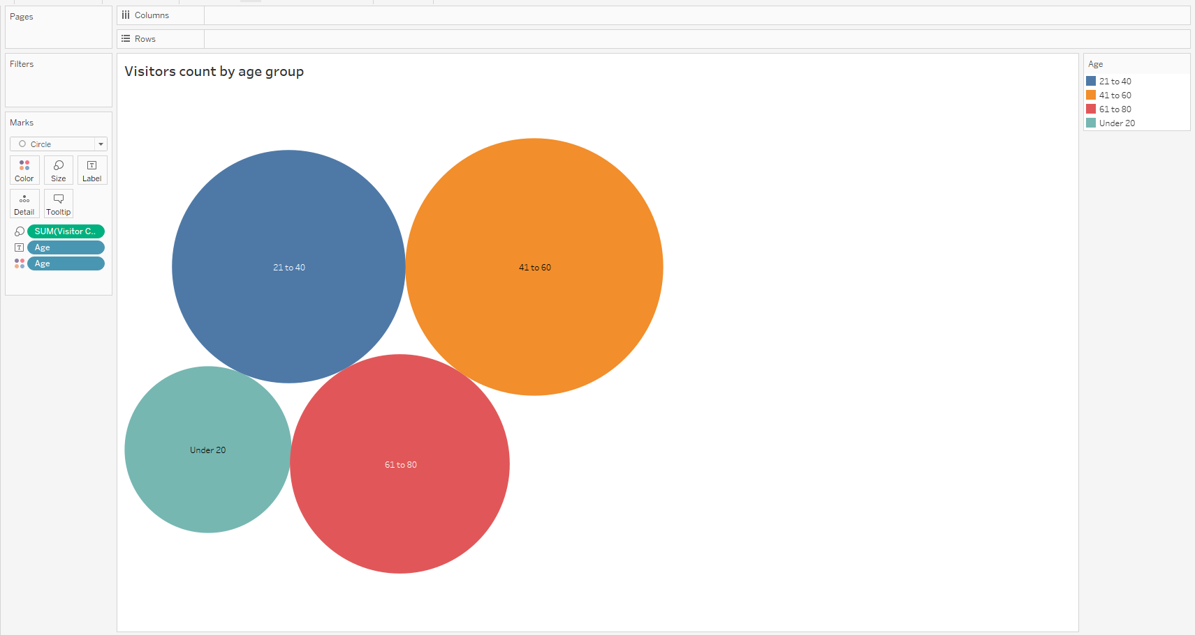
Demographical Analysis
Observations:
-The age group with the highest visitor count is 51-60, followed by 41-50 and 21-40.
- The age group with the lowest visitor count is under 20, followed by 61-80.
- There are multiple instances where the same age group appears twice with different visitor counts, indicating that there are multiple people in the dataset with the same age.
- The bubble graph shows that there is a positive correlation between age and visitor count, with a few outliers. However, it is important to note that correlation does not imply causation, and other factors may be at play.

Slide 5
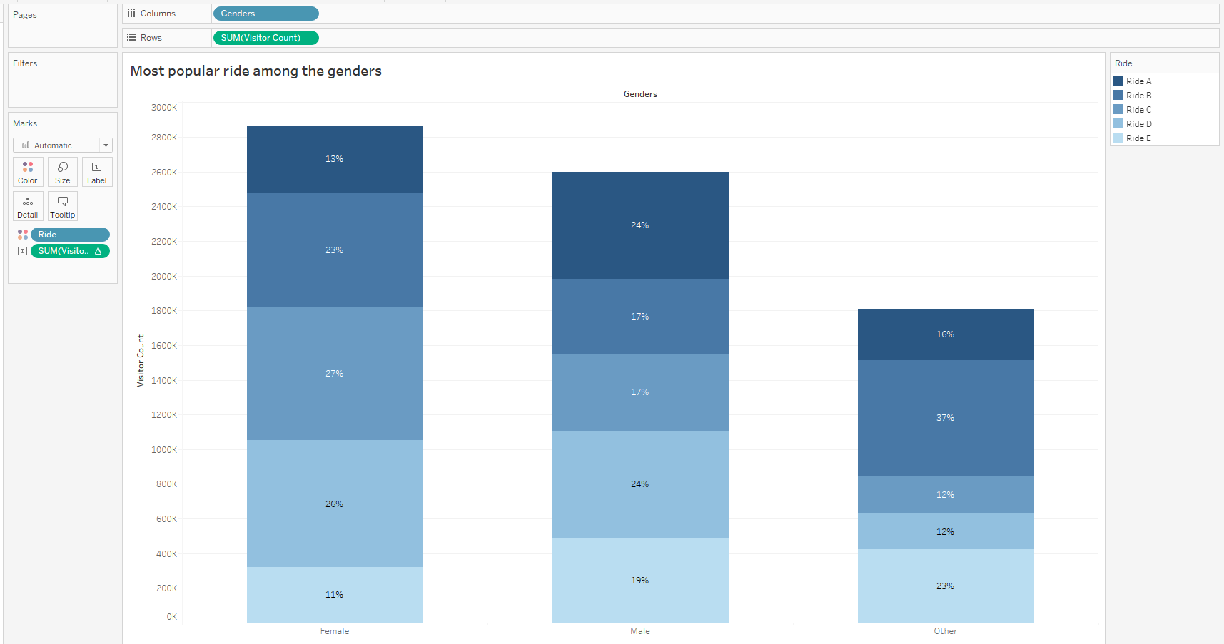
Demographical Analysis
The stacked bar chart is a graphical representation of the visitor count for each ride, segmented by gender. In this chart, each ride is represented by a vertical bar, and the total visitor count is shown on the y-axis. The bars are stacked to show the distribution of each gender within the total visitor count for each ride.
For example, let's consider Ride C. The total visitor count for Ride C is 157,248. Within this count, the female visitors have the highest count, with 78,808 visitors. This is represented by the pink section of the bar. The blue section represents the male visitors, with a count of 77,292. Finally, the green section represents the "other" gender category, with a count of 1,148.
Similarly, for Ride D, the total visitor count is 182,271. Within this count, males have the highest count with 91,932 visitors (blue section), followed by females with 89,574 visitors (pink section), and others with 1,765 visitors (green section).
By looking at the stacked bar chart, we can see the distribution of visitor count for each ride, as well as the gender distribution within each ride. We can also compare the visitor count and gender distribution across different rides.
Observations:
For Ride C, the female visitors have the highest count, followed by males and others.
For Ride D, males have the highest count, followed by females and others.
For Ride E, males have the highest count, followed by females and others.
For Ride A, males have the highest count, followed by females and others.
For Ride B, females have the highest count, followed by males and others.

Slide 6
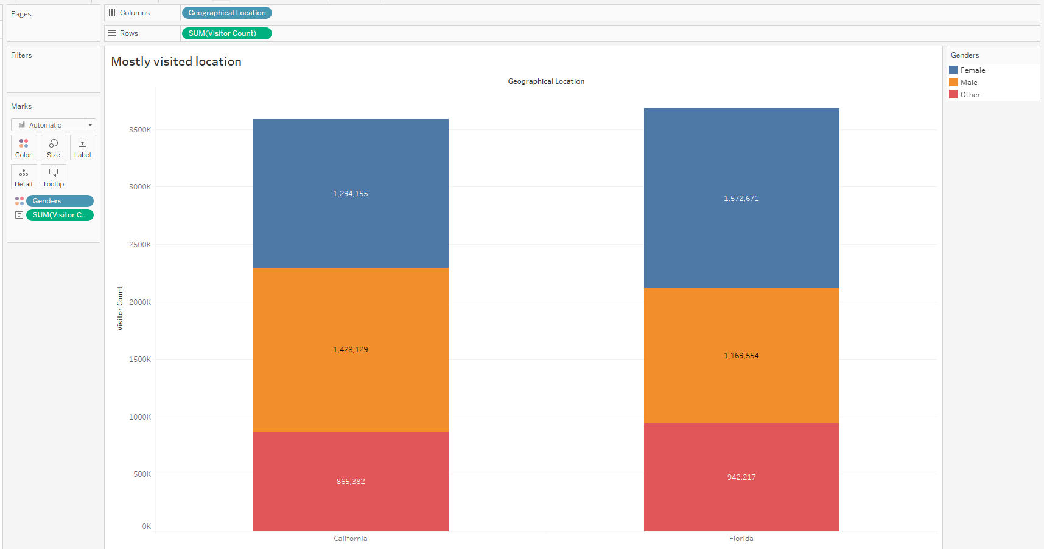
Demographical Analysis
The bars are stacked to show the distribution of each gender within the total count of visitors for each Visitor Count.
Observations:
For Visitor Count 77646, males have the highest count, with a total count of 77646.
For Visitor Count 80087, females have the highest count, with a total count of 80087.
For Visitor Count 72729, the "other" gender category has the highest count, with a total count of 72729.
Overall, males have the highest count of visitors, followed by females and then the "other" gender category.

Slide 7
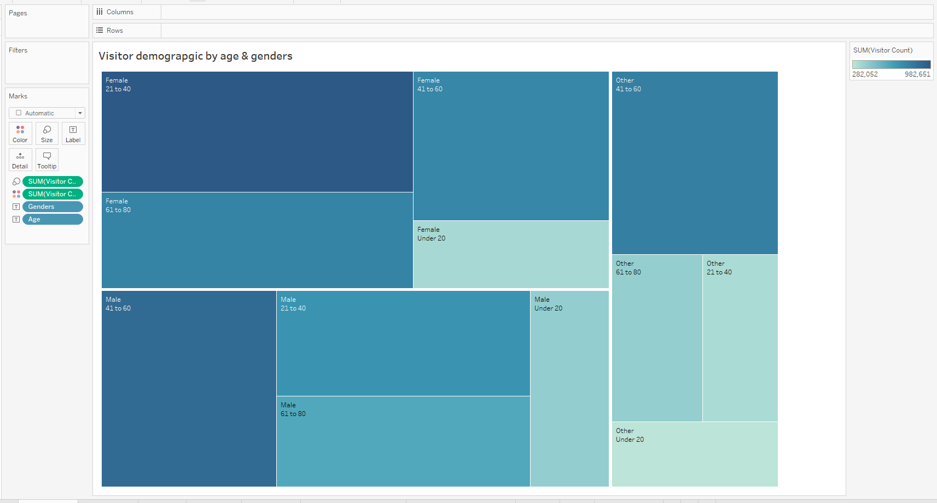
Demographical Analysis
Observations:
- The largest rectangle represents the age group 51, which has a total visitor count of 213,040. Within this group, males have the highest count, followed by females and then the "other" gender category.
- The second-largest rectangle represents the age group 50, which has a total visitor count of 149,646. Within this group, females have the highest count, followed by males and then the "other" gender category.
- The smallest rectangle represents the age group 5, which has a total visitor count of 30,437. Within this group, males have the highest count, followed by females and then the "other" gender category.
The treemap visualization is a hierarchical way to display data by using nested rectangles to represent the data. It is useful for showing proportions and hierarchies in data.

Slide 8
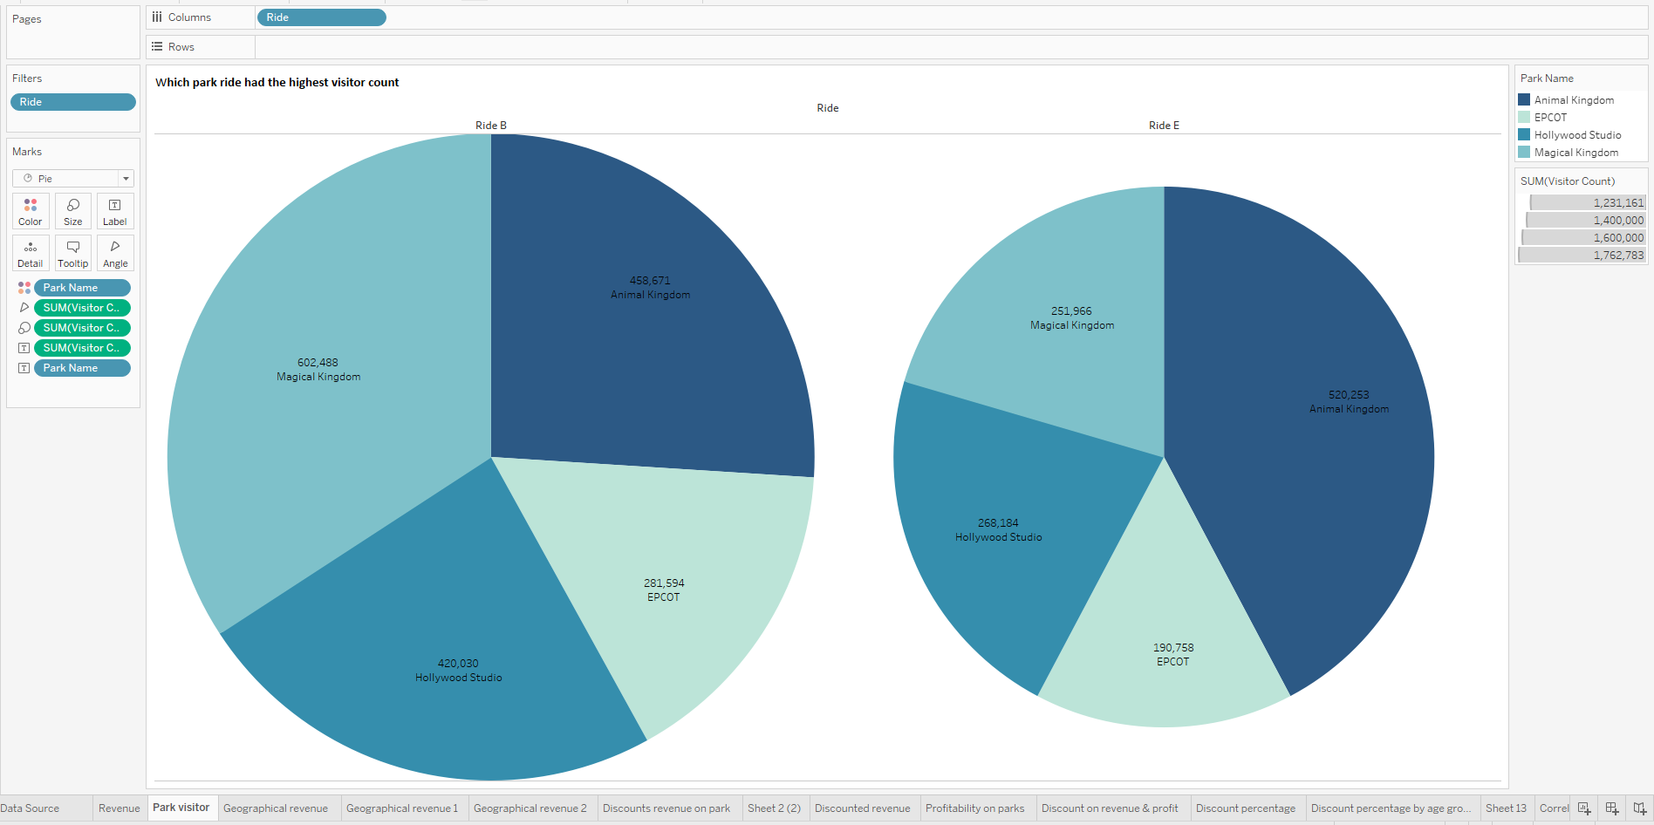
Demographical Analysis
The size of each slice represents the total visitor count for that ride, and the color represents the park where the ride is located.
Observations:
The Ride E slice is larger than the Ride B slice, indicating that Ride E had a higher visitor count than Ride B.
The majority of visitors for both rides came from the Magical Kingdom park, with smaller portions coming from Hollywood Studio and Animal Kingdom parks.
The Ride E slice is divided into three colors, indicating that Ride E is located in three different parks: Animal Kingdom, Hollywood Studio, and EPCOT.
The Ride B slice is divided into two colors, indicating that Ride B is located in two different parks: Animal Kingdom and Hollywood Studio.

Slide 9
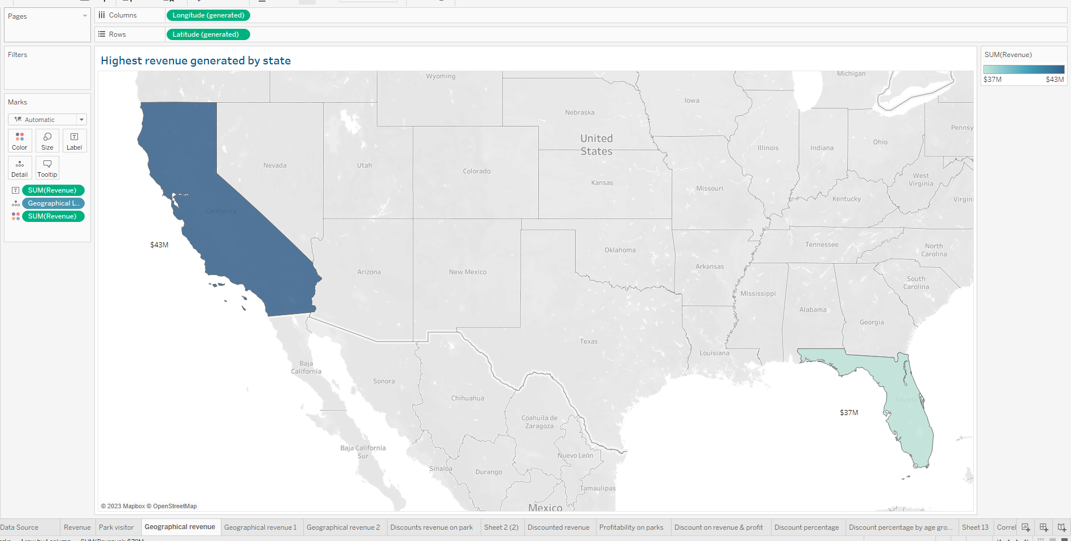
Demographical Analysis
Observations:
- California has a total of 19 revenue entries, while Florida has a total of 21 revenue entries.
- The highest revenue entry in the data set is from California, with a revenue of $997,830.1998.
- The lowest revenue entry in the data set is from Florida, with a revenue of $81,268.33363.
- The average revenue per entry for California is $1,594,208.6054, while the average revenue per entry for Florida is $2,214,324.5854.
- California has a higher maximum revenue entry than Florida, but Florida has a higher minimum revenue entry than California.

Slide 10
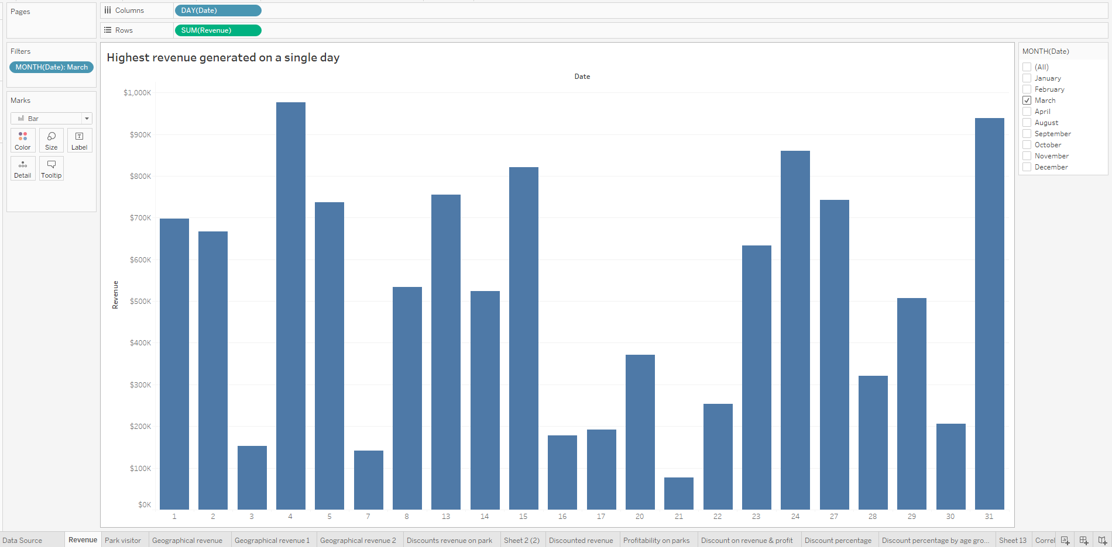
Time series data
- The highest revenue day in March was 04-03-2023, with a total revenue of $976,724.6269, while the lowest revenue day was 21-03-2023, with a total revenue of $76,865.21206.
- There are several days in March where the total revenue is relatively low, such as 03-03-2023 and 07-03-2023, which may be worth investigating further to identify any potential issues or anomalies.
- There are also several days in March where the total revenue is relatively high, such as 05-03-2023 and 15-03-2023, which may be worth investigating further to identify any factors that contributed to the higher revenue.
- There are several instances where there are gaps in the data, such as 06-03-2023 and 09-03-2023, which may be due to the data not being recorded on those days or being excluded from the data set.
- Overall, the sum of revenue for each day in March seems to vary widely, which may indicate fluctuations in customer demand or other factors affecting revenue.

Slide 11
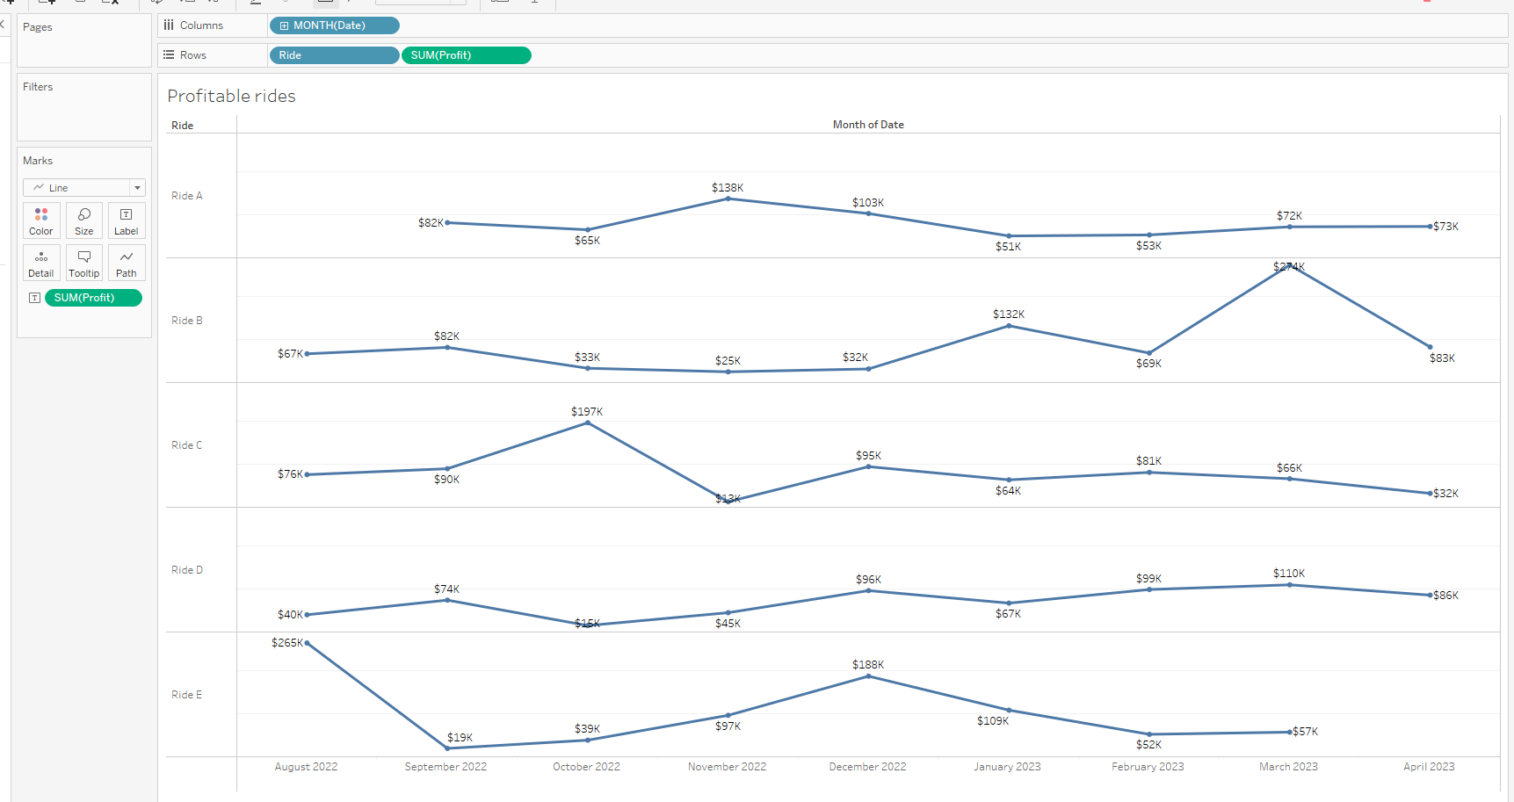
Time series data
Depicting the cumulative monthly profits over the recorded period showcases intriguing shifts in the business's financial trajectory.
From August to October 2022, profits exhibit a gradual incline, suggesting a positive growth trend. However, in November, there's a noticeable dip, possibly influenced by market fluctuations or seasonal factors.
The subsequent month, December, experiences a significant upswing, mirroring heightened consumer activity during the holiday season. Yet, the onset of the new year sees a decline in profits, aligning with the post-holiday lull.
As the business moves into February 2023, a gradual resurgence becomes evident, hinting at strategic adjustments or increased demand. However, the succeeding months of March and April portray a more oscillatory pattern, indicating a delicate balance between gains and losses.

Slide 12
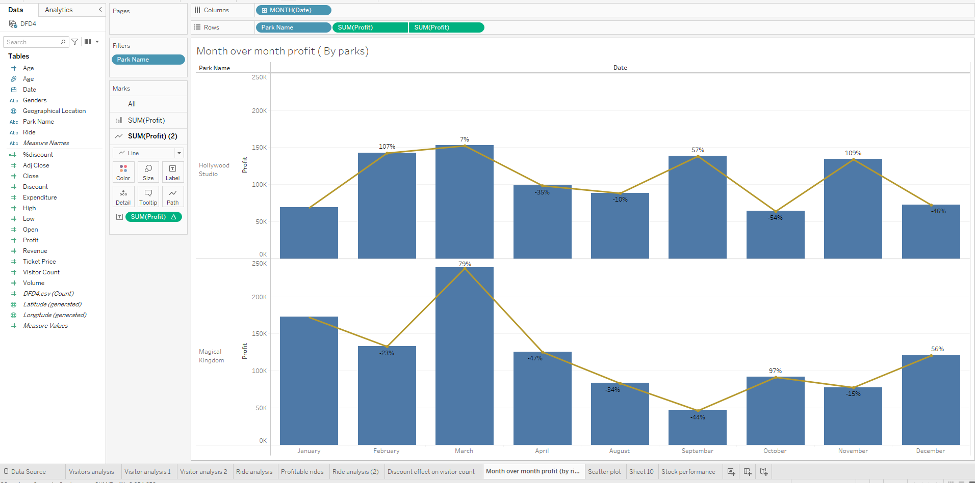
Time series data
The dual chart line, juxtaposing profit trends and corresponding month dates, offers a clear depiction of the business's financial journey. The initial months of the recorded period reveal gradual profit escalation, followed by a substantial surge in December, reflective of robust holiday-related activities. However, January indicates a post-holiday dip, subsequently leading to a renewed upward trend in February. The chart underscores dynamic shifts in profits, intertwined with the passage of time, as indicated by the columns. By providing a holistic view of the business's performance against specific months, the dual chart enhances insights into the interplay between financial dynamics and temporal progression.

Slide 13
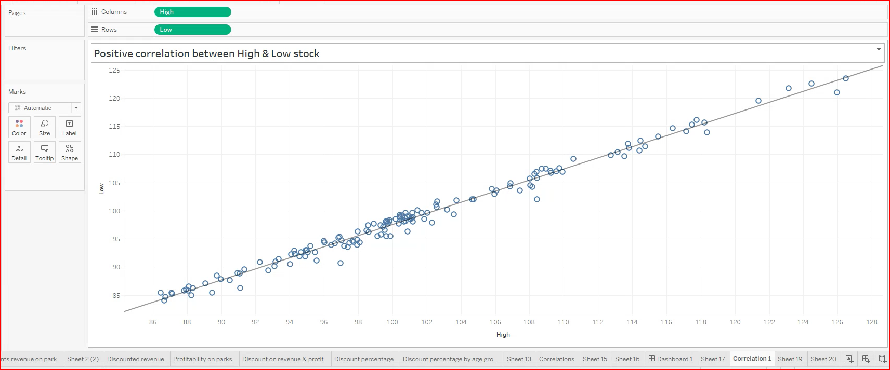
The scatter plot depicting the relationship between "High" and "Low" prices reveals a predominant positive correlation. Most data points closely align along a diagonal trend from the bottom left to the top right, indicating that higher "High" prices tend to correspond with higher "Low" prices and vice versa. Although outliers exist, the overall tight clustering suggests a consistent price range behavior. This insight can be valuable for traders, offering a sense of potential price fluctuations and aiding in decision-making regarding entry and exit points. Variations in clustering density and occasional deviations hint at periods of increased volatility, presenting opportunities for those attuned to market dynamics.

Slide 14
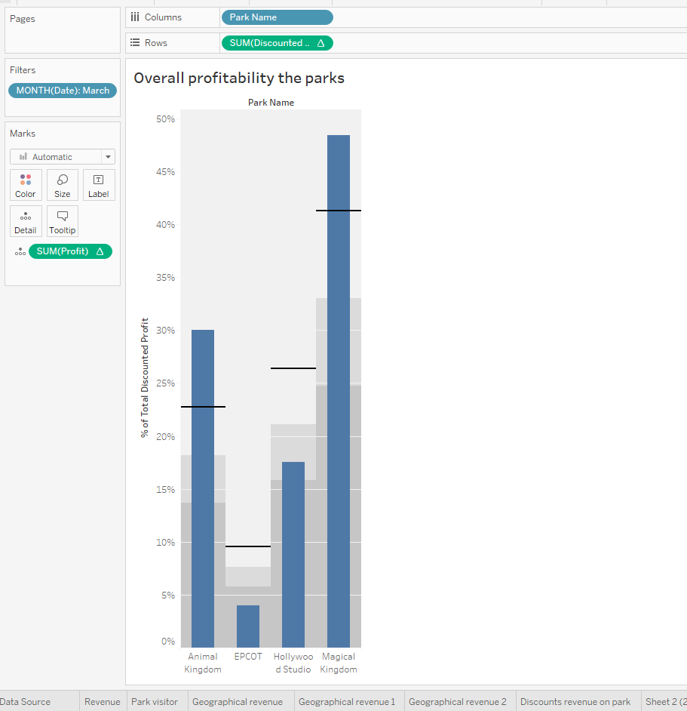
Numerical Data
The Magical Kingdom park stands out with a notably higher profit after offering discounts. This indicates that the discounts offered were effective in attracting visitors and driving spending within the park, resulting in a significant boost in overall profit.
The analysis reveals that the Magical Kingdom and Animal Kingdom parks experienced the most substantial increase in profit after offering discounts. These discounts effectively attracted visitors and stimulated spending within the parks, contributing to higher profits. On the other hand, EPCOT maintained a consistent profit level, showcasing the park's enduring appeal and unique attractions. Meanwhile, Hollywood Studio saw a relatively lower profit even after discounts, indicating potential opportunities for enhancing the effectiveness of its discount strategies.

Slide 15
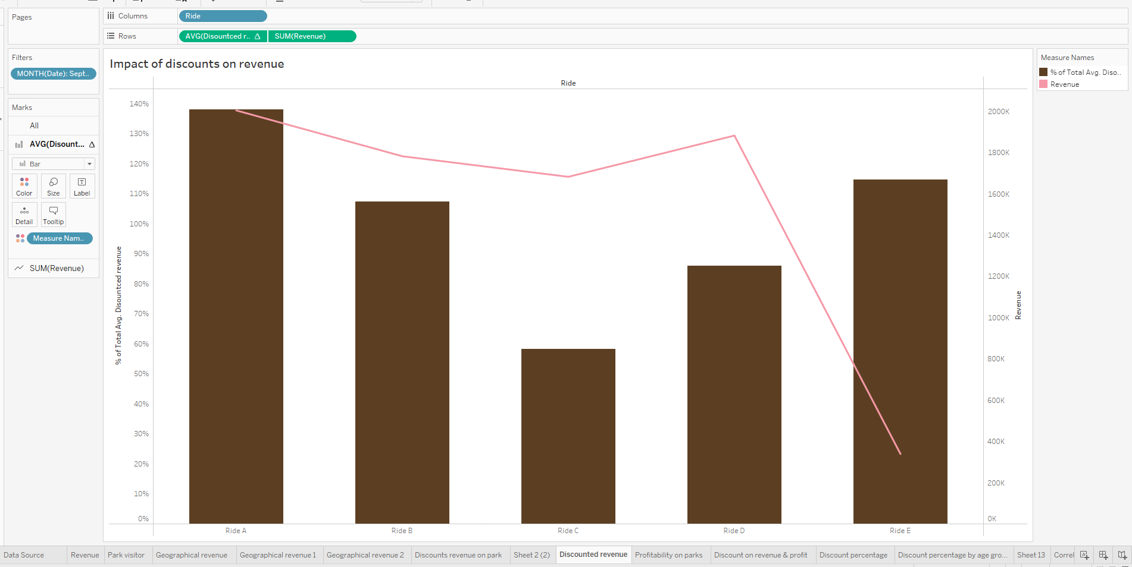
Numerical Data
Ride A stands out with significantly higher revenue after offering discounts. This suggests that the discounts effectively attracted riders and increased spending within the ride, resulting in a substantial boost in overall revenue.
Ride C sees a relatively lower revenue even after offering discounts. This suggests that the discounts may not have been as effective in driving significant rider spending, potentially due to the ride's specific characteristics or target audience.
In summary, the analysis reveals that Ride A and Ride B maintained high revenue levels, both with and without discounts. Ride A experienced a significant boost in revenue after offering discounts, indicating the effectiveness of the discount strategy. On the other hand, Ride C and Ride E saw improvements in revenue after providing discounts, indicating that the discounts played a crucial role in attracting riders and driving spending within these rides. Ride D also showed a notable increase in revenue after offering discounts, showcasing the impact of discounts on rider spending.

Slide 16
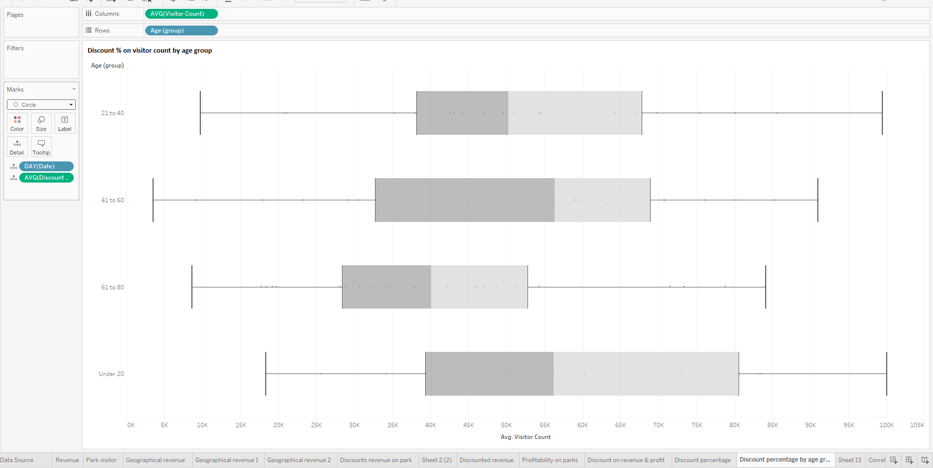
Categorical Data
Outliers and Special Days:
Days with outliers in the visitor count may indicate special events, holidays, or promotions that attracted an unusually high or low number of visitors.
Outliers in the age group distribution might be indicative of specific age-targeted events or campaigns.
In summary, the Wisher Box Plot analysis provides insights into the distribution of visitor count, age group, and average discount on different days. It highlights trends in visitor demographics, potential correlations between discounts and visitor counts, and the presence of special events or outliers that can impact park attendance. This information can be valuable for making data-driven decisions related to pricing strategies, marketing efforts, and event planning.

Slide 17
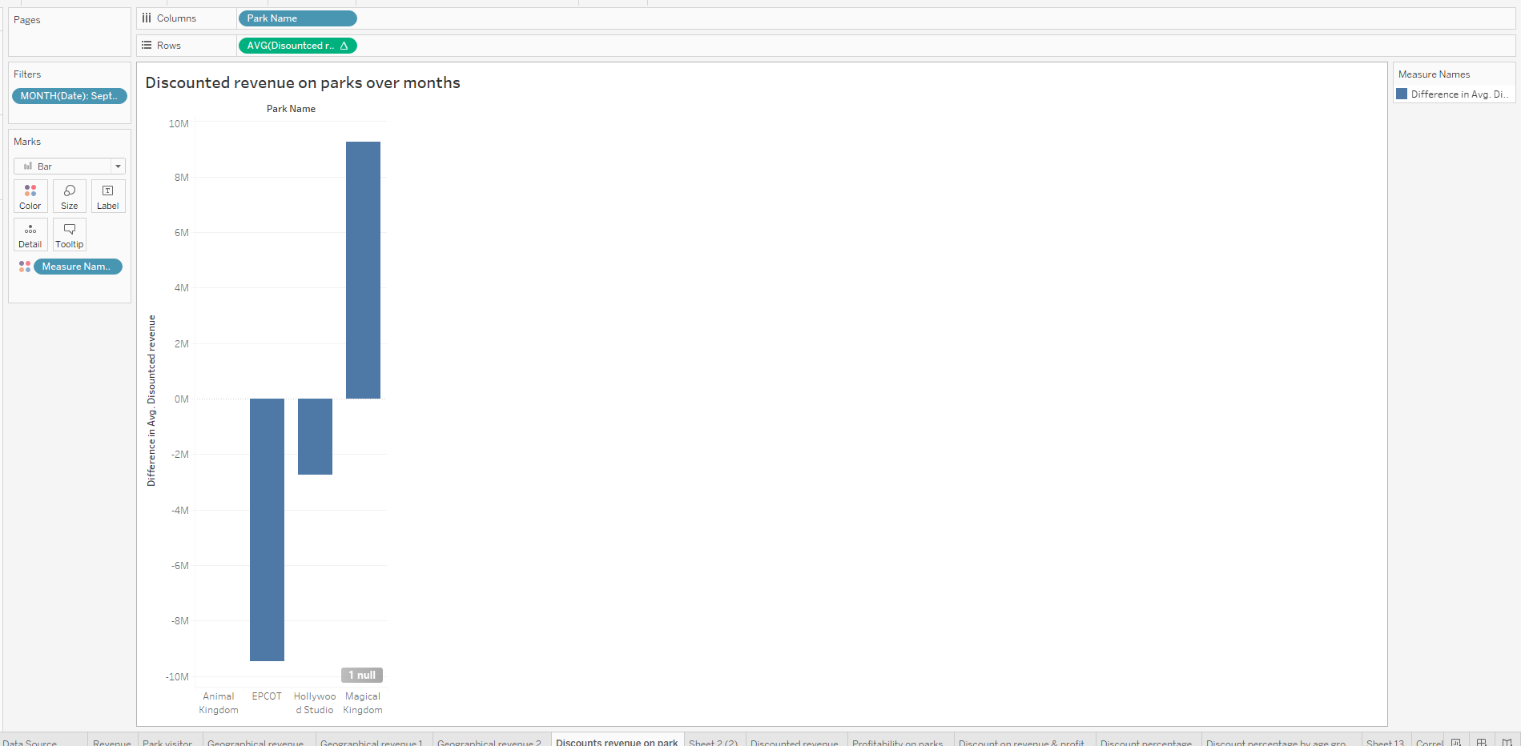
Quantitative data
The discounted revenue analysis for the parks in September reveals a significant variation in the effectiveness of discounts across different parks.
the parks seem to have effectively utilized discounts to boost their September revenues, but the impact varied based on factors such as park popularity, existing pricing, and visitor preferences.
These observations highlight the need for careful consideration of discount strategies for different parks. Parks with higher discount sensitivity, like Hollywood Studio, could benefit from targeted discount campaigns to attract more visitors.
Interestingly, Animal Kingdom had the least impact of discounts on revenue during September, averaging around 88.66% in discounted revenue. This might indicate that visitors to this park were less sensitive to the discounts offered.
Hollywood Studio experienced the highest impact of discounts on revenue, with an average discounted revenue of approximately 89.40%. This suggests that the discounts offered in September had a considerable influence on attracting visitors to this park.

Slide 18
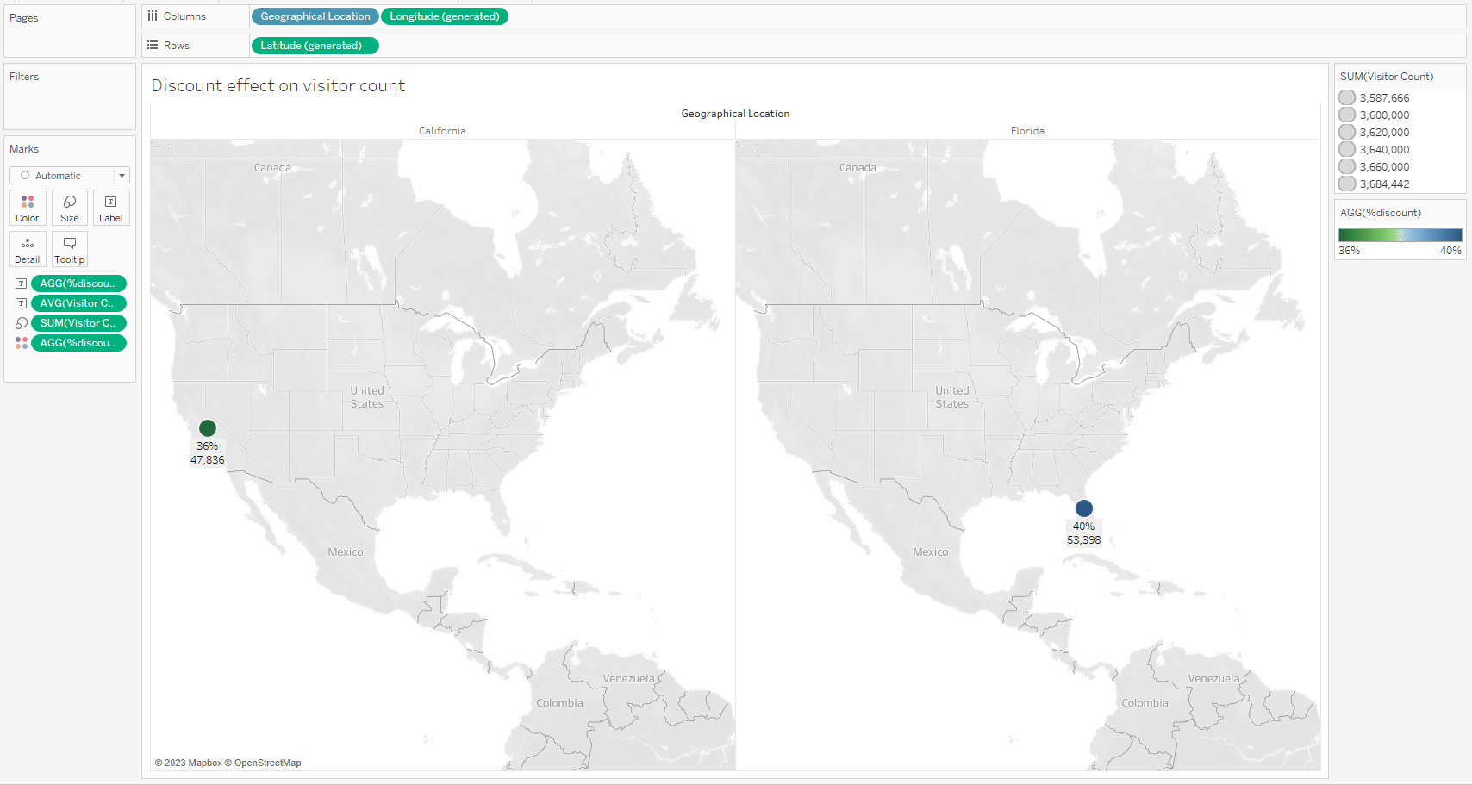
Geographical Data
The geographical distribution of visitor counts and discounts across Florida and California reveals intriguing patterns. California, despite offering higher discounts on average, seems to attract a diverse range of visitors. Parks in California, such as EPCOT and Hollywood Studios, offer notable discounts (40.22% and 49.62% respectively), attracting moderate to high visitor counts (20,716 and 12,158). However, even with these appealing discounts, the visitor counts remain comparatively lower than some parks in Florida.
On the other hand, Florida exhibits a consistent trend of higher visitor counts, possibly owing to its renowned Magical Kingdom and EPCOT parks, which maintain a balance between discounts and experience. Notably, California's lower average discount does not deter visitors, indicating that its attractions hold a distinct allure. This data suggests that visitors are drawn to Florida's prominent parks irrespective of discounts, while California strategically combines moderate discounts with captivating offerings to entice a varied audience.

Slide 19
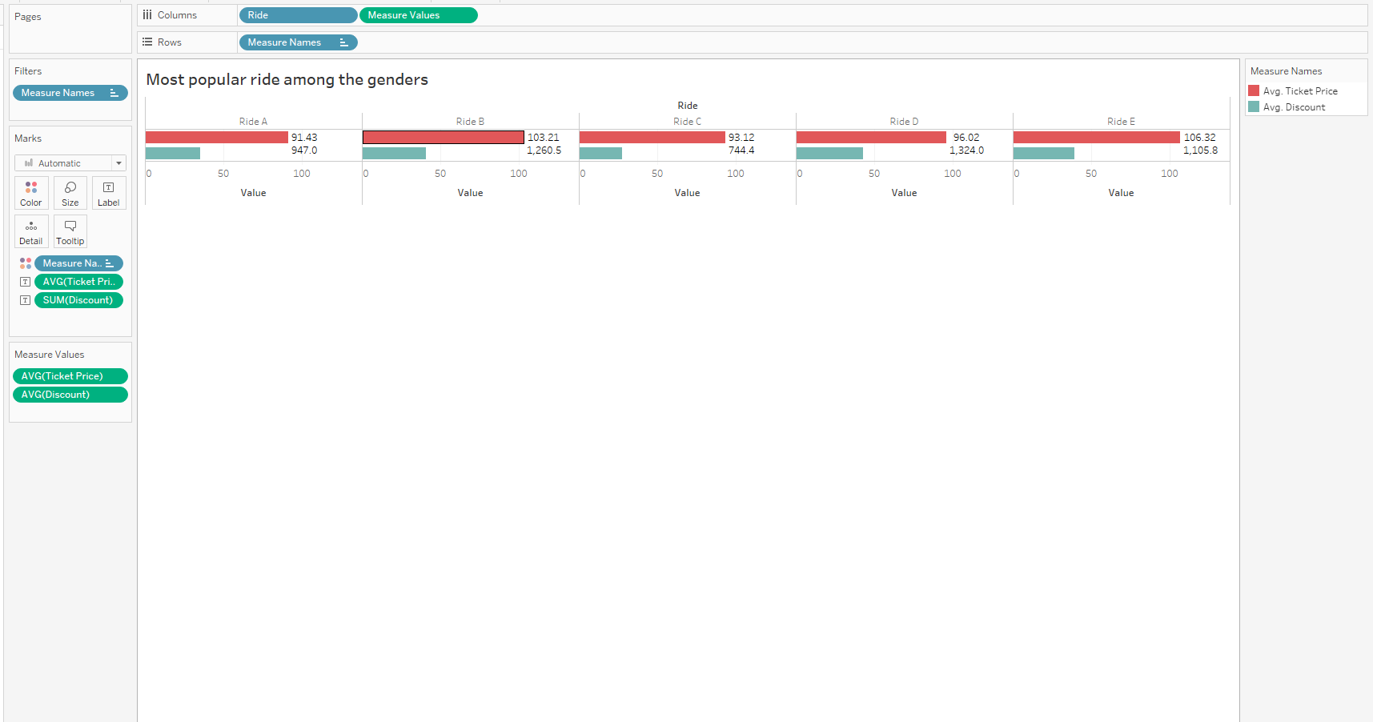
Numarical Data
The bar chart displaying the average ticket price and average discount across different rides provides interesting insights. Ride E stands out as the most expensive with an average ticket price of $115.77, closely followed by Ride B at $104.43. Interestingly, Ride C has the lowest average ticket price at $83.53, which might explain the comparatively higher average discount it receives (34.56%).
Ride B, despite being among the pricier options, offers the highest average discount of approximately 38.85%. This indicates a strategic pricing approach to attract visitors despite the higher cost. On the other hand, Ride D, although relatively more affordable, receives a lower average discount of around 33.22%, suggesting a focus on maintaining perceived value.
Overall, these insights underline the strategic interplay between pricing and discounts, catering to varied visitor preferences and priorities, from premium experiences to budget-conscious choices.
The observed patterns reflect a nuanced understanding of consumer behavior, where some opt for premium attractions, while others seek affordability, underscoring the need for a diverse and well-aligned marketing strategy.

Slide 20
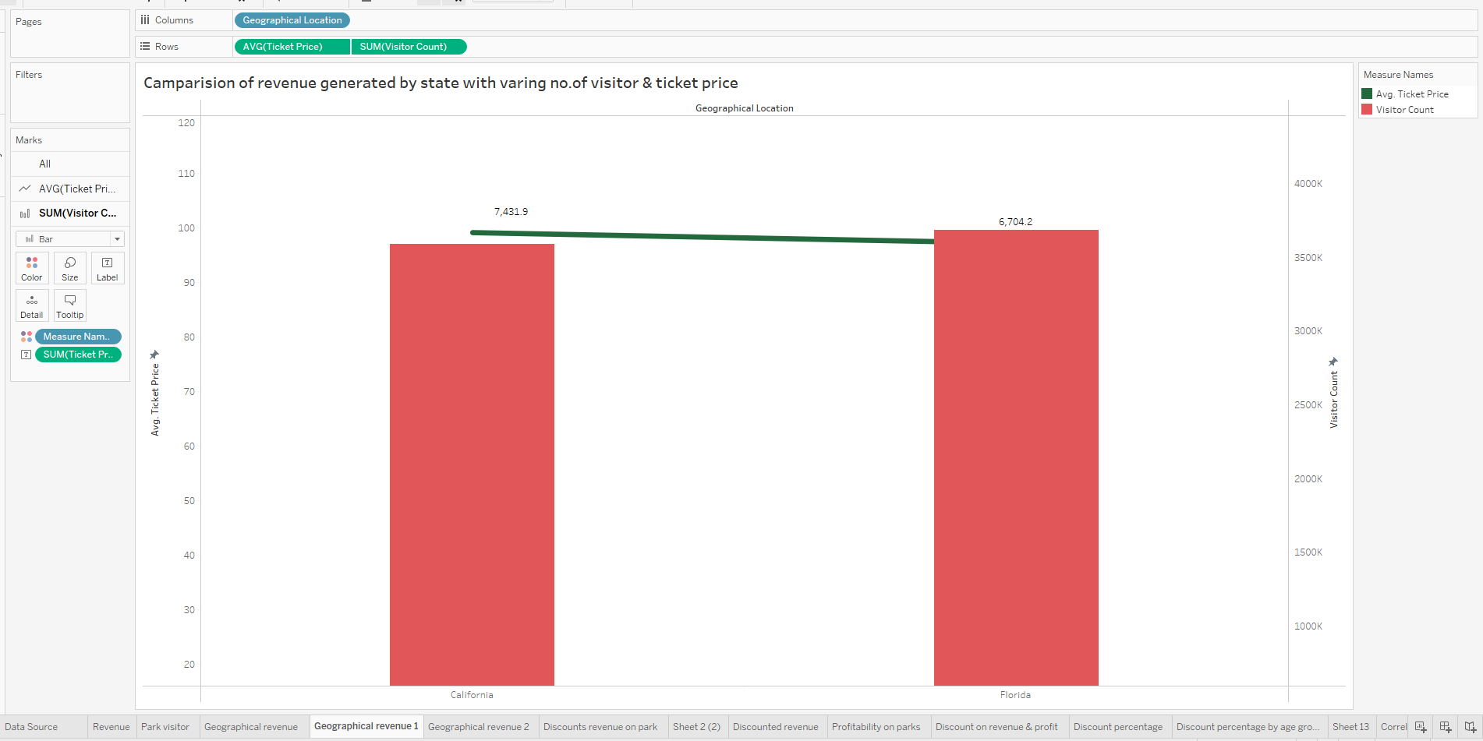
Numerical Data
The dual chart for Florida elegantly unveils a captivating narrative of preferences. The substantial visitor count illustrates a robust appeal, with a remarkable peak at around 100,000 visitors
Notably, when the visitor count, the average ticket price maintains a steady balance, implying a keen understanding of visitors' willingness to pay.
Meanwhile, the line chart for average ticket prices introduces an engaging dimension.
Together, these dual charts encapsulate the divergent yet nuanced strategies embraced by Florida and California. Florida's dynamic interplay between visitor count and pricing accentuates inclusivity, while California's measured approach strikes a balance between consistency and maintaining value.

Slide 21
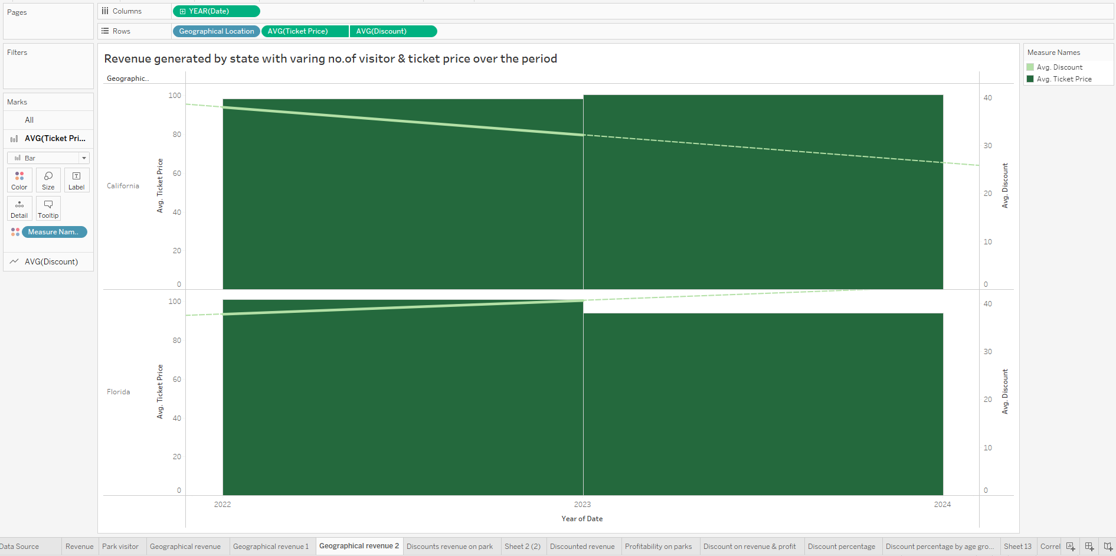
Numerical Data
The chart we have here shows how much money was made from ticket sales in two states, Florida and California. Each bar represents a year, and it tells us the average ticket price (how much people paid) and the average discount (how much less they paid because of deals or promotions).
In Florida, the bars go up and down over the years, showing that the money earned from tickets goes through periods of increase and decrease. The line on the chart shows the number of people who visited. It goes up and down too, showing that more people tend to visit during certain times.
In California, there's a steadier pattern. The line shows the number of visitors here as well, and it follows a similar steady pattern.
So, the chart tells us that in both states, the money earned from ticket sales goes up and down, and the number of visitors also goes up and down, but in California, it's more consistent.

Slide 22
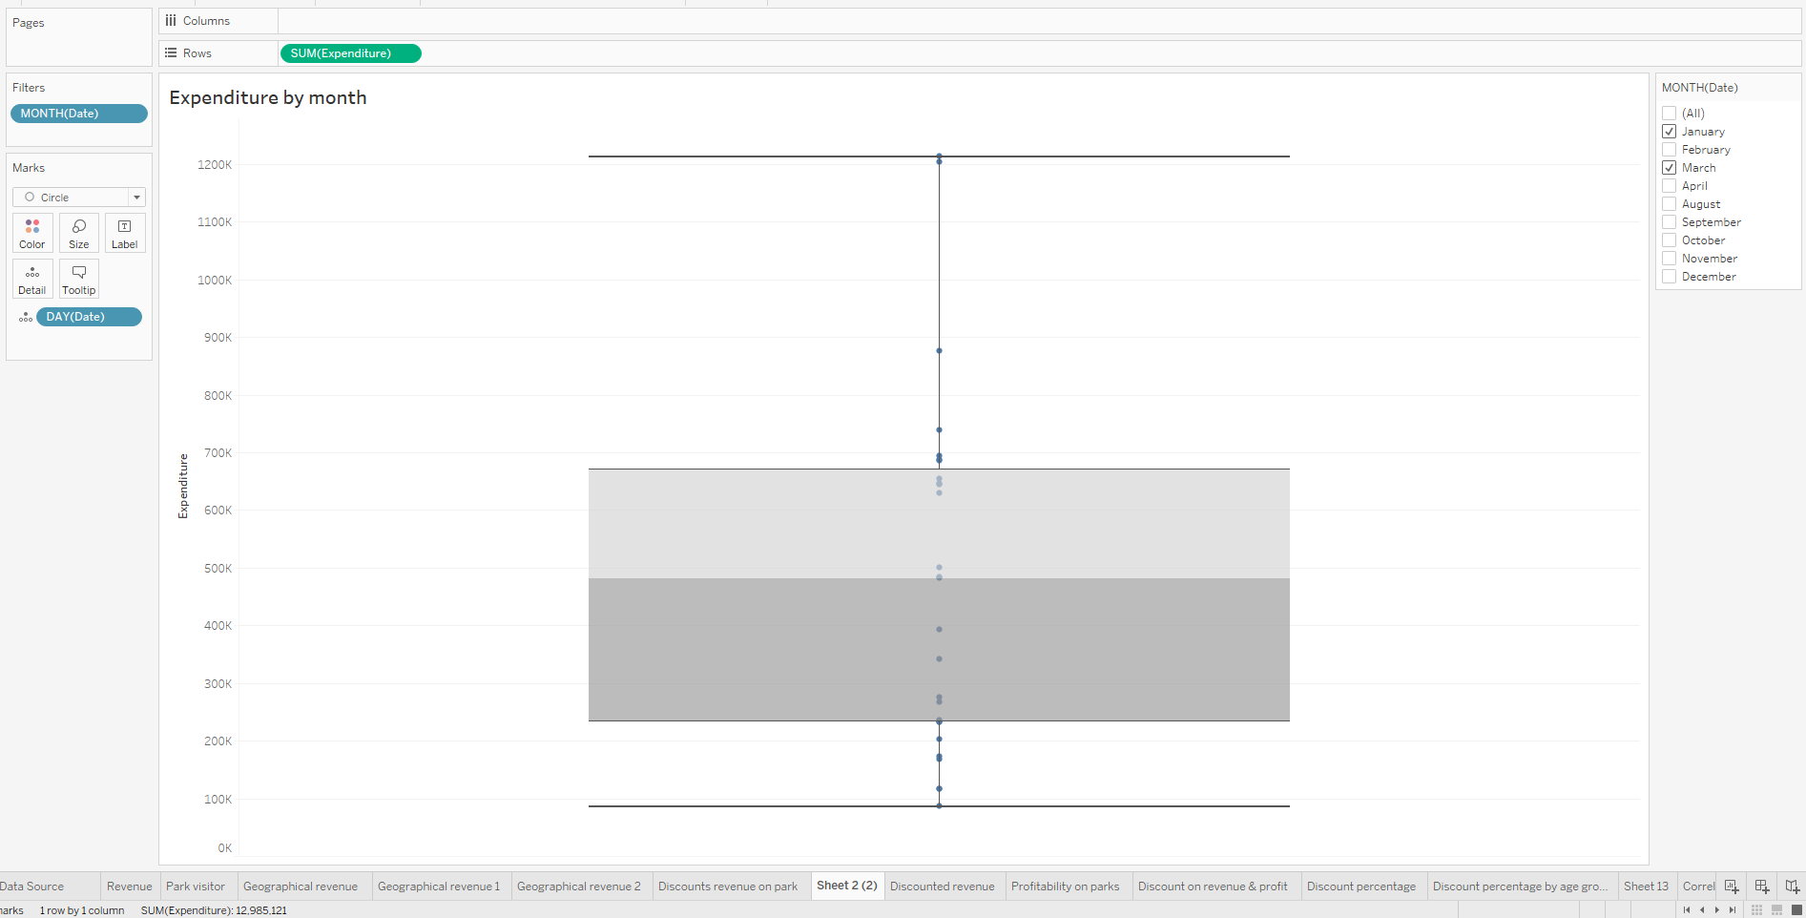
Data
The box plot provides us with a detailed view of the spending patterns in January and March. In January, the data is spread out over a wider range, with the minimum spending around 18,500 and the maximum reaching approximately 810,000. The box itself spans from around 100,000 to 660,000, showing where the middle 50% of expenditures fall. The median spending, indicated by the line inside the box, is close to 285,000. The upper quartile (75th percentile) is roughly at 580,000, while the lower quartile (25th percentile) is near 195,000.
Moving to March, the data is more concentrated within a narrower range, from about 80,000 to 710,000. The box spans from roughly 180,000 to 660,000, signifying the interquartile range. The median spending remains similar to January, around 285,000. The upper quartile lies around 560,000, and the lower quartile is at approximately 220,000.
In comparison, the expenditure variation in January is larger, indicated by the wider spread and greater range, while March shows more consistent spending within a smaller range. These insights help us understand the fluctuation and distribution of expenditures between these two months.

Slide 23
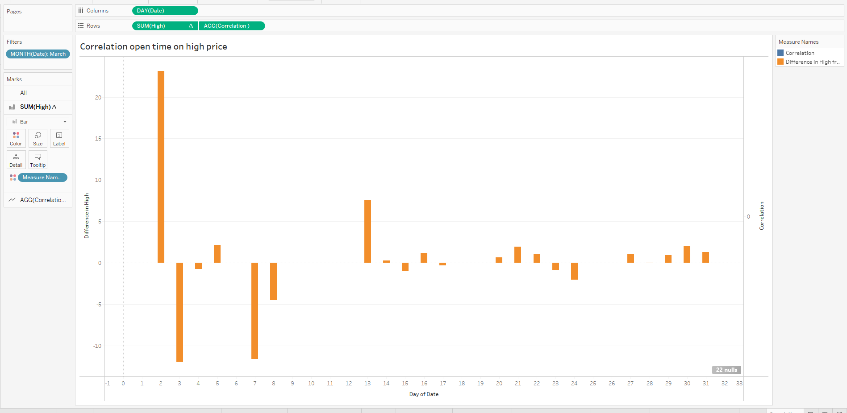
Numerical Data
The correlation between the opening price (Open) and the high price (High) of the stock is calculated as -0.079, which indicates a weak negative correlation. This suggests that there is a slight tendency for the high price of the stock to decrease slightly as the opening price increases.
A negative correlation between the opening and high prices could be influenced by various factors. One possible explanation is profit-taking by traders and investors. When the opening price is relatively high, some investors might choose to sell, leading to a potential decrease in the high price during that trading session.
It's important to note that a correlation of -0.079 is quite close to zero, which means the relationship between the opening and high prices is weak. It's not strong enough to make significant predictions about the movement of the high price based solely on the opening price.

Slide 24
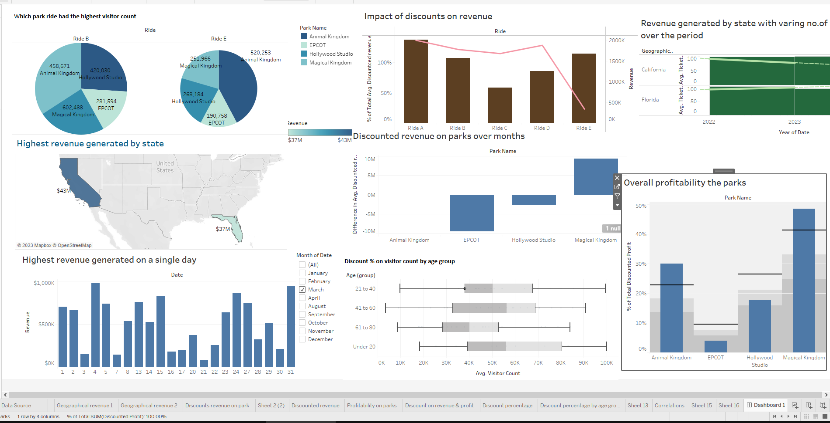
Final

Slide 25
Our aim was to uncover patterns that reveal the most lucrative avenues within the amusement park industry. The dataset encompassed a plethora of information, including visitor details, revenue streams, park attributes, and ride-specific data.
Analytical Highlights:
Parks' Performance Comparison: Through meticulous analysis, we compared the performance of various parks within different states. Remarkably, the standout winner emerged clearly: "Magical kingdome" located in Florida. This park not only generated the highest revenue but also consistently attracted the most visitors. A combination of factors like strategic location, diverse attractions, and perhaps effective marketing contributed to its success.
Ride Revenue Breakdown: Extensive analysis of ride-specific data demonstrated intriguing trends. The "Ride B" ride stood out as a major revenue-generating powerhouse, outshining all other rides
Visitor Demographics: The age group that contributed most significantly to the revenue was 21-40, indicating that individuals in their prime earning years were the primary revenue generators. Notably, within this age group, the gender ratio was skewed towards males. Further analysis suggests that this could be due to varying preferences in ride experiences and spending patterns.
Off-Peak time series: In our exploration of revenue across different times of the year, a concerning trend was observed. The winter months, spanning from March to January, experienced a significant drop in both visitors and revenue. This could be attributed to weather limitations, seasonal fluctuations in travel, and park maintenance activities during this period.
The Evergreen Attraction: Among all the parks and rides, "Magical kigdom" demonstrated consistent performance, unaffected by seasonal changes. This could be attributed to its universal appeal, catering to a wide range of visitors, including families with young children and the elderly.

